Slide 1
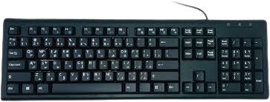

Mechanical and Typewriter Keyboards
Understanding Keyboard Types & Their Unique Features
Submitted By
Md Taminul Islam
Merit: 4633. Dept Of CSE, BU
Submitted To
Md Mahbub-E-Noor
Assistant professor, Dept Of CSE, BU

Slide 2
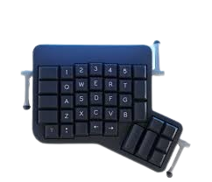
Overview of Mechanical Keyboard
Which are built for precision & durability
What is Mechanical Keyboard?
A mechanical keyboard uses individual mechanical switches beneath each key, providing a more tactile, durable, and responsive typing experience than any normal keyboard.
Key Features of Mechanical Keyboards:
Different switch types
Ideal for long-term use
Customizable Options
Better Typing Sense & Sound
Gaming Functions
Faster Responses
Anti-ghosting
Highly durable
Why Choose a Mechanical Keyboard?
Mechanical keyboards are preferred for their durability, typing feel, and customization options. They suit a variety of users, including gamers, typists, and programmers who want a reliable, personalized typing experience.

Slide 3
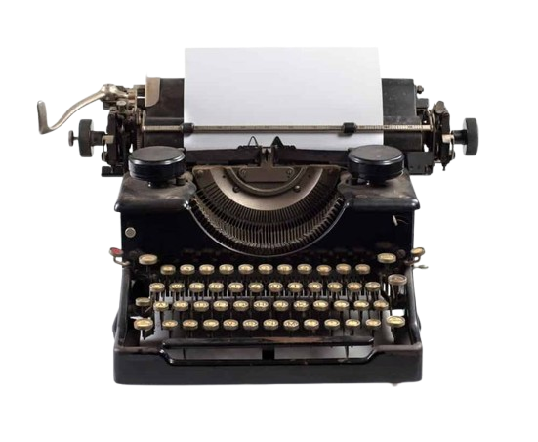
Overview of Typewriter Keyboard
The beginnings of typing: The first-ever keyboards designed for writing
What is a Typewriter Keyboard?
A typewriter keyboard is a layout of keys designed for typing letters, numbers, and symbols on a typewriter, an early mechanical device used to print text on paper.
Key Features of Typewriter Keyboards:
No Need for Electricity
Unique Typing Sound
Ink Ribbon System
Click-clack Sound
Manual Tab Key
Fixed Line Spacing Options
Shift Key for Capitals
Mechanical Keys
Why Choose a Typewriter Keyboard?
A typewriter keyboard is ideal for those who enjoy the simplicity of analogue tools. Its distinct design encourages focused, distraction-free writing without digital interruptions. Plus, it doesn’t require electricity, making it reliable and portable. For writers and collectors, it’s also a unique and charming alternative to modern keyboards.

Slide 4

No Need for Electricity
Ink Ribbon System
Click-clack Sound
No Gaming Functions
Fixed Line Spacing Options
Durable & Reliable
Unique & Analogue
Need for Electricity
No Ink Ribbon System
Virtual Sound
Best for Gaming
Customizable Options
Highly durable
Modern keyboard

Slide 5
Thank you for watching my presentation

